Slide 1
Mobile Presentation
Jasmine Naraine & Keenan Flynn

Slide 2

Introduction
Android Studio
Integrated Development Environment (IDE) for Android app development.
Features
Instant App Run
Visual layout Editor
Fast Emulator
Addition of New Activity as a Code Template
Help to Build Up App for All Devices

Slide 3
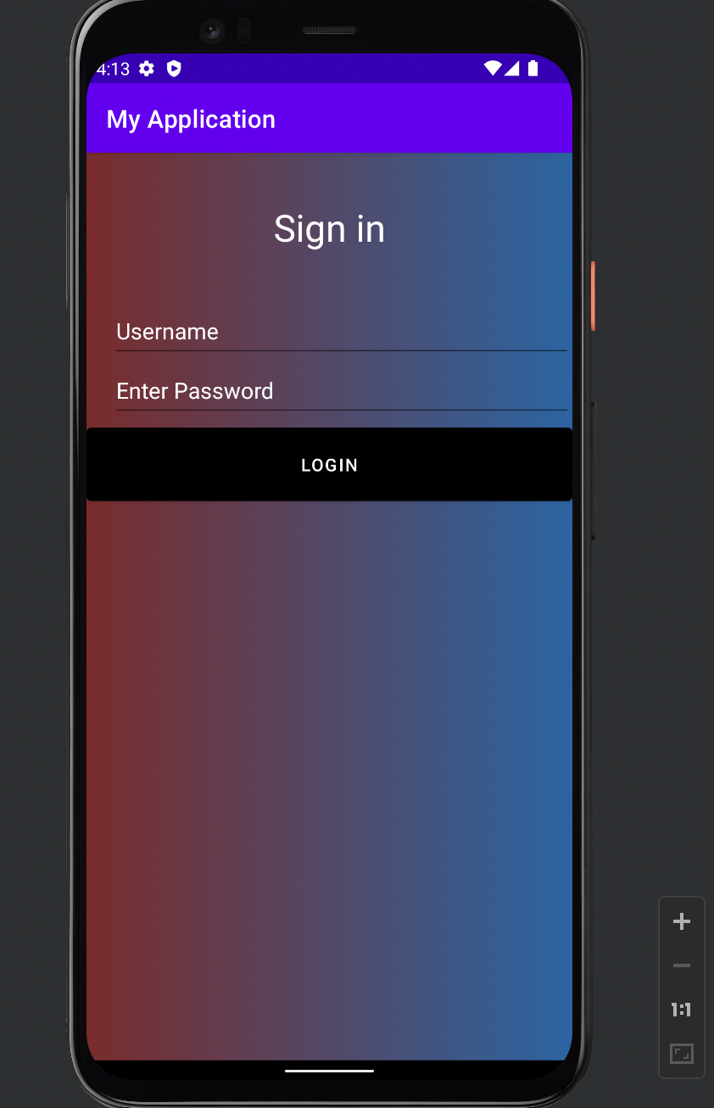
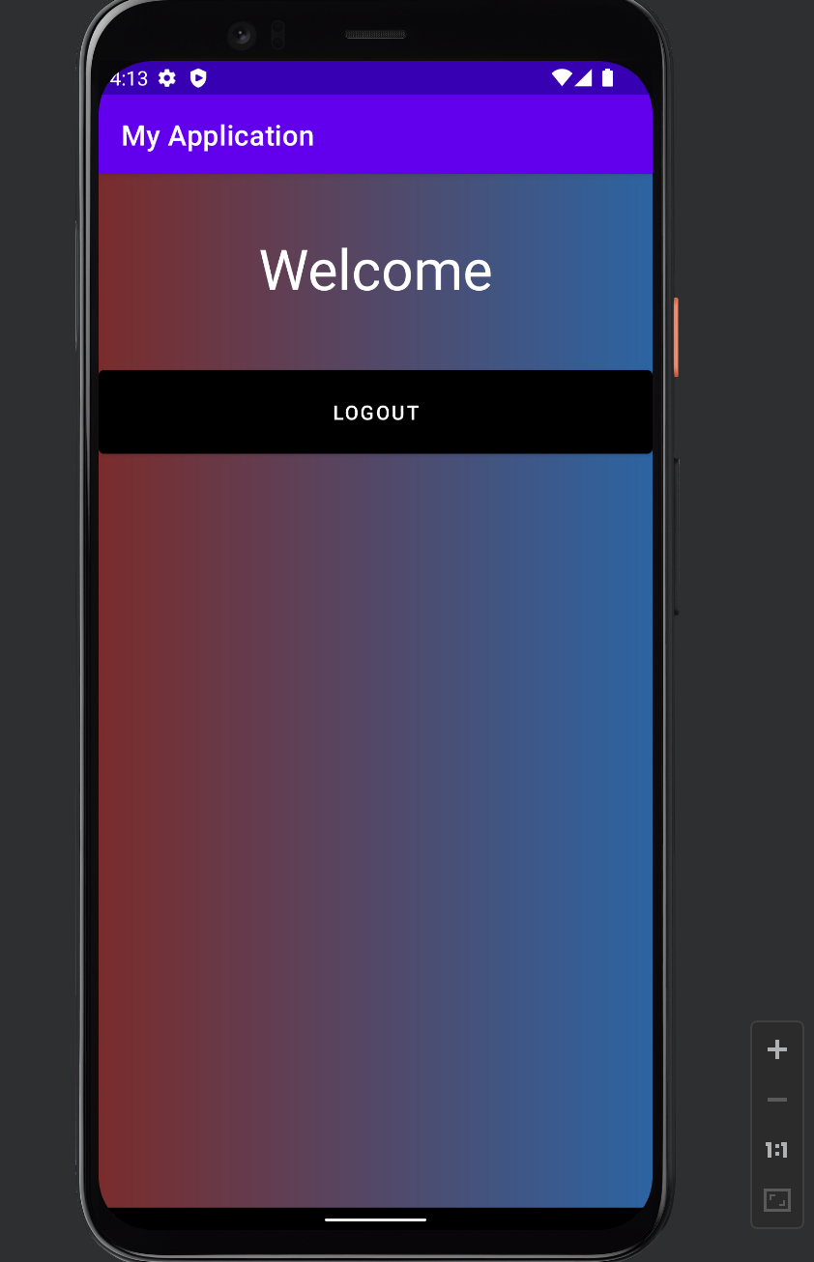
ICP8
Created two activity screens
Using explicit intent to switch between the login page to the logout page and back to the login page with OnClick method
Login
If user input incorrect username or password, using Toast method it provide feedback that there was an error

Slide 4
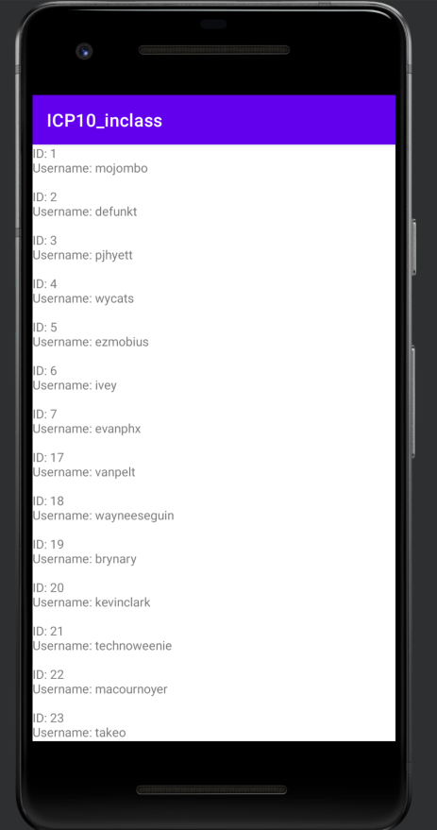
ICP 10
API
Using Restful API to retrieve GitHub user to display users on the app.
In MainActivity.java we built an API Collection that stores out GET request.
Retrofit was the easiest way to crest a type-safe HTTP client for Android
Retrofit turns HTTP API into a Java interface

Slide 5

Conclusion
To conclude, using Android Studio we were able to comprehend the software to
Build advanced and fully developed applications
Create layouts in XML to view the users view
Constraint layout and relative layout
Using the Emulator to see how the application looks like and it gives it real-time experience to test the application.

Slide 6
Links
GitHub
Keenan Flynn – kpfxn8@umsystem.edu – https://github.com/kfly2fly/Web-Mobile-Spring-2022
Jasmine Naraine- jnytc@umstyem.edu - https://github.com/JNaraine/490-Mobile
Video Link: https://youtu.be/w6K3gdjOPu0

